Slide 1
Project Presentation Christopher Columbus Game
Subject: Software Develop & Engineering- CSCI 513.
Professor: Dr. Mona Rahimi, Ph.D.
Team:
Dinesh Kaveri - Z2049493
Venkata Sai Darshan Madamsetty - Z2049028
Date: 28-Apr-2025

Slide 2
Summary
Game Functionality.
UML Diagrams.
Sequence Diagrams.
Test Cases.
Design Highlights.
Tasks (load) sharing.
Project Documentation.

Slide 3
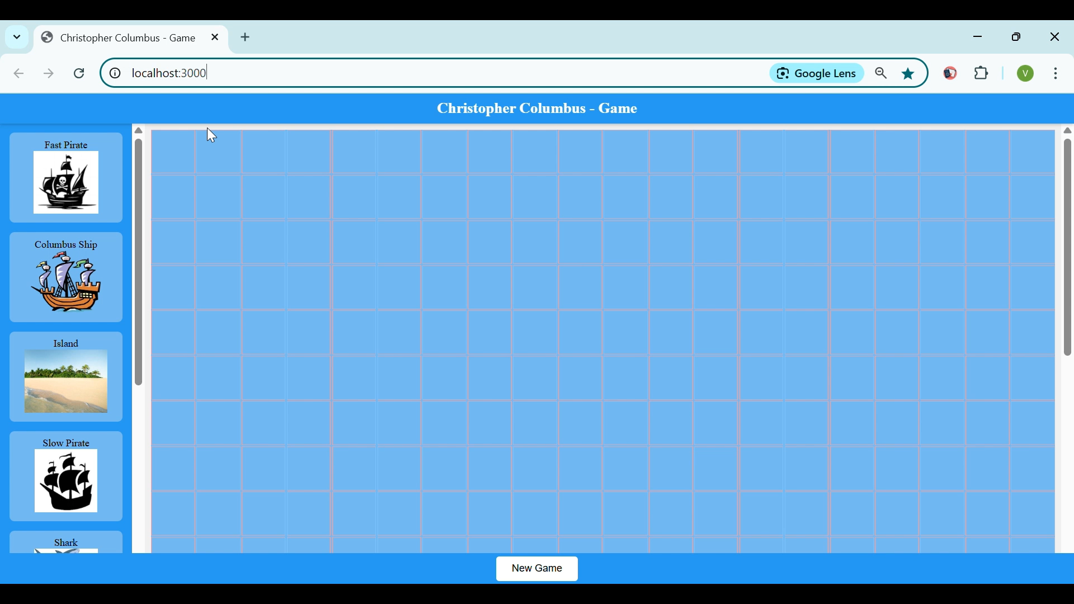
Game Functionality Setting the Grid – Singleton Design Pattern

Slide 4
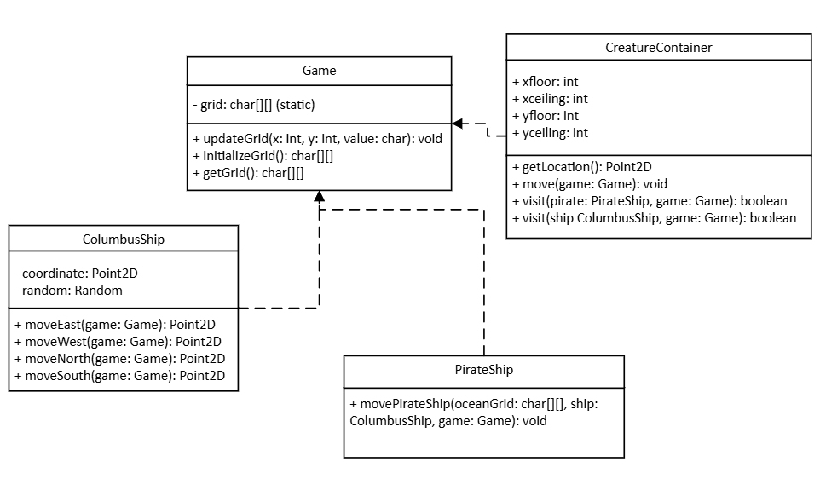
UML Diagrams Singleton Design Pattern

Slide 5
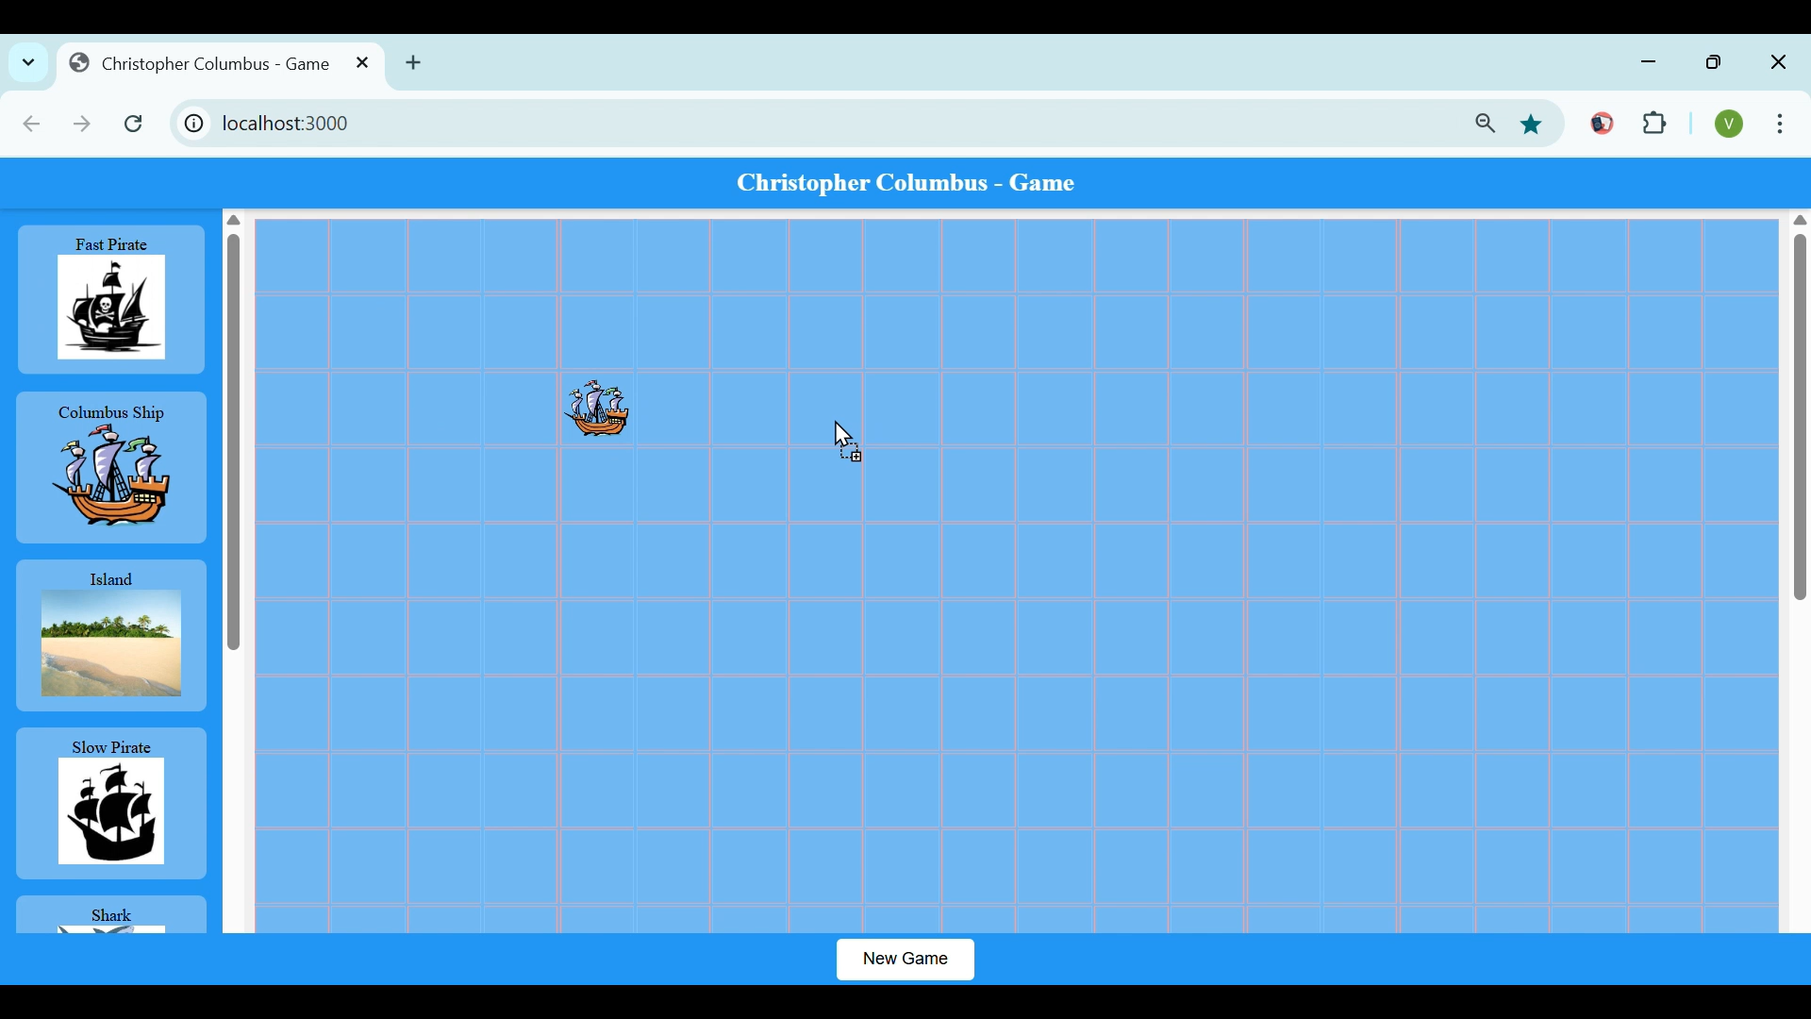
Game Functionality Pirates – Factory Method – Fast Pirate & Slow Pirate

Slide 6
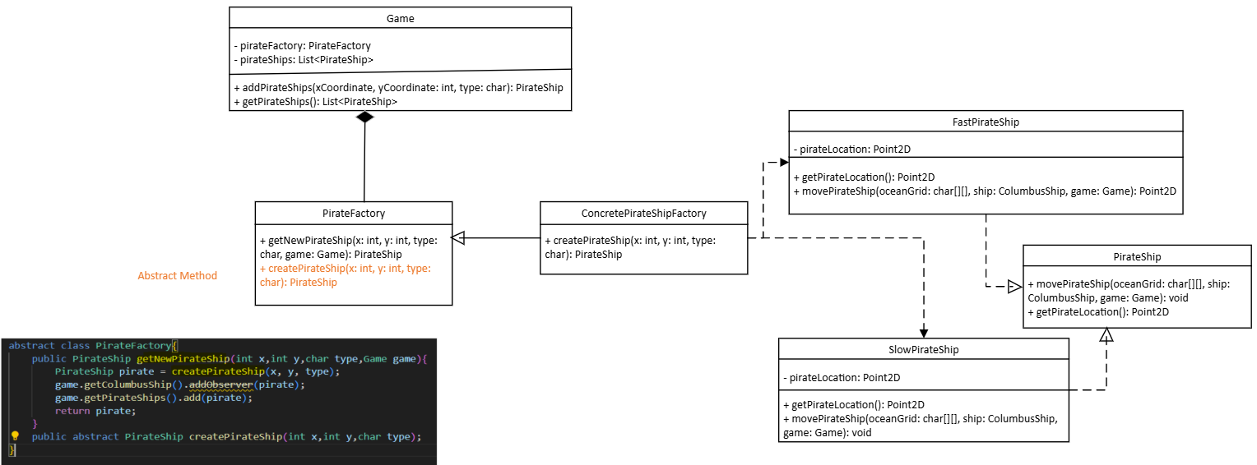
UML Diagrams Factory Method

Slide 7
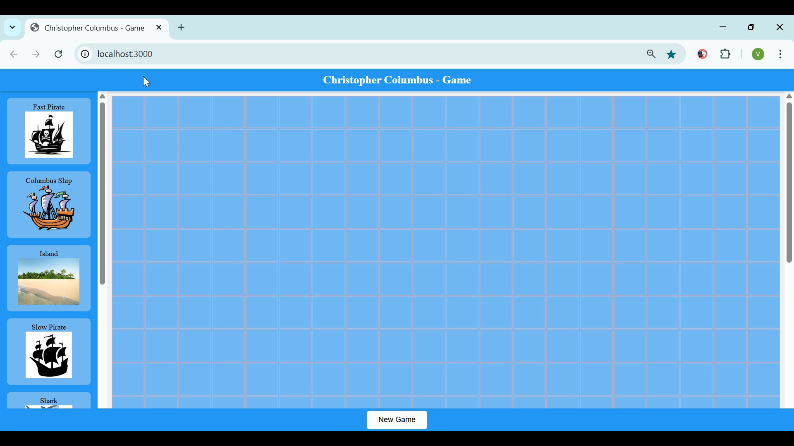
Game Functionality Pirates - Observer & Strategy Design Patterns

Slide 8
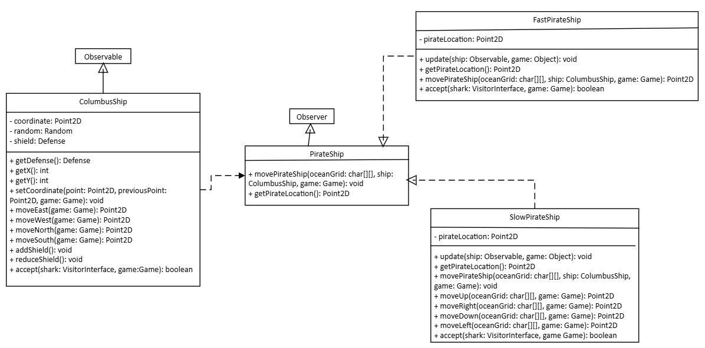
UML Diagrams Observer Design Pattern

Slide 9
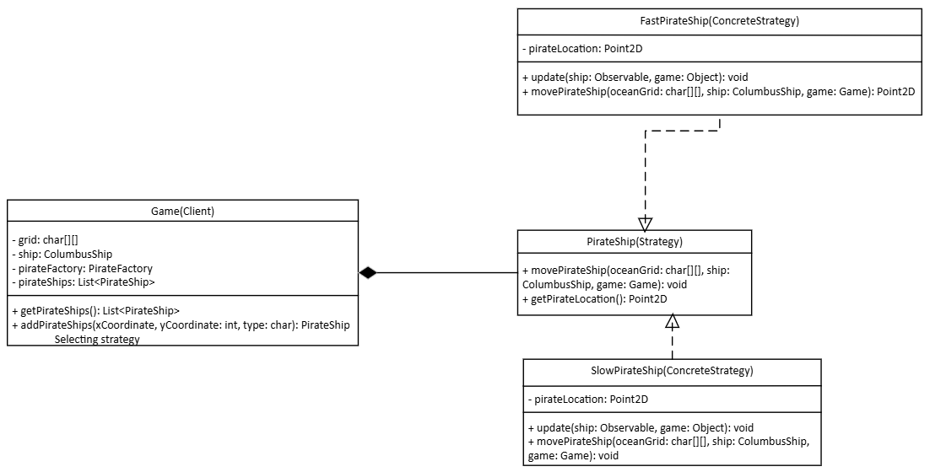
UML Diagrams Strategy Design Pattern

Slide 10
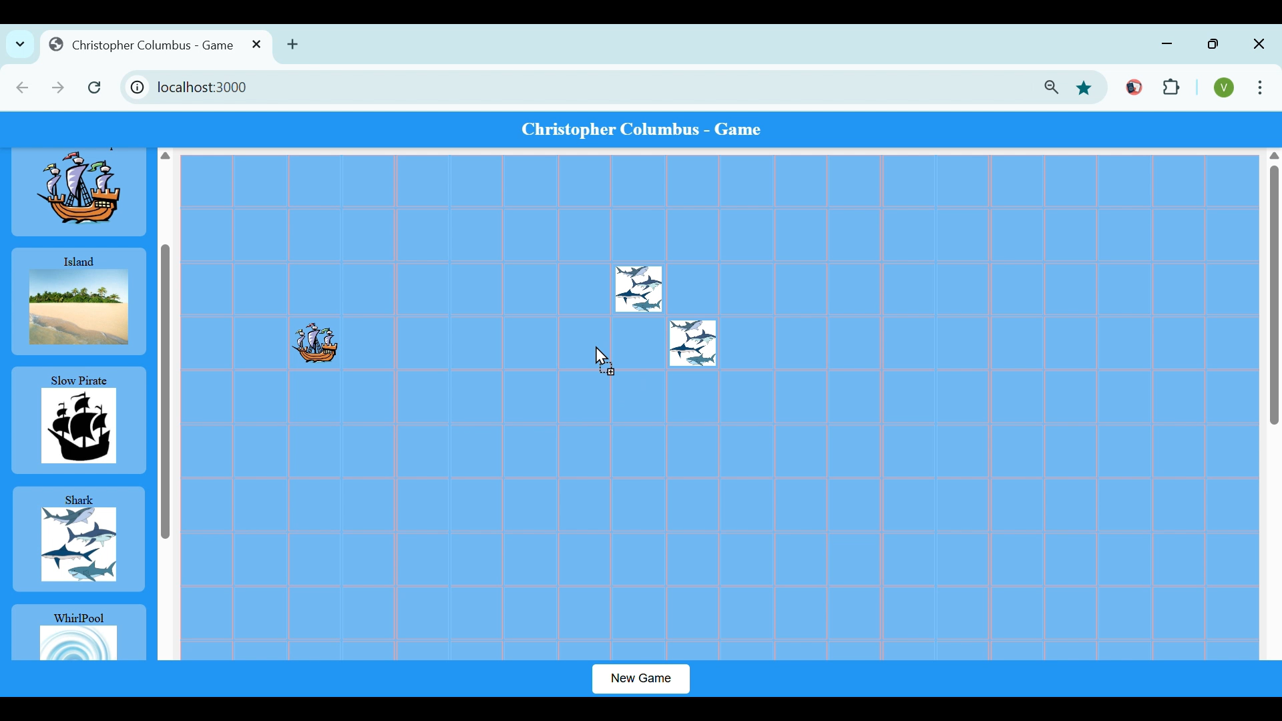
Game Functionality Sea Creatures - Composite Design Pattern

Slide 11
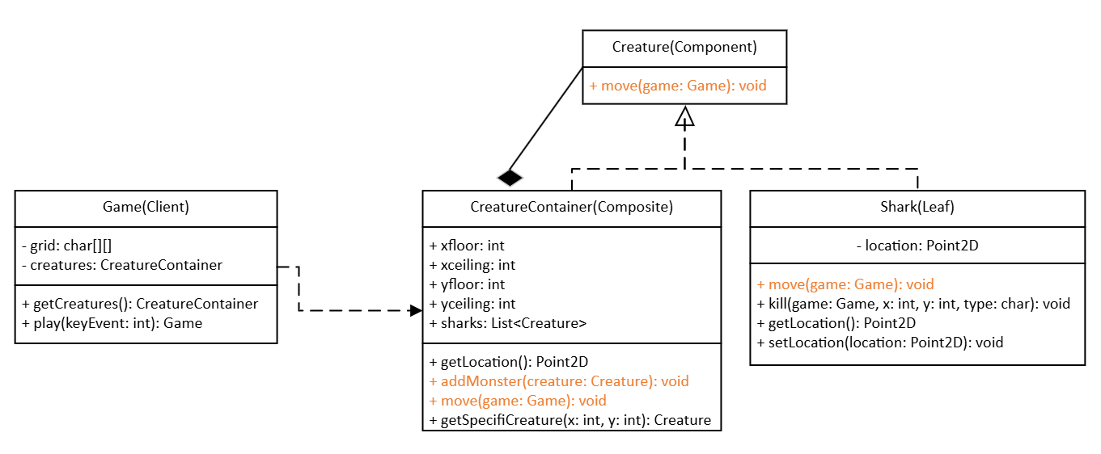
UML Diagrams Composite Design Pattern

Slide 12
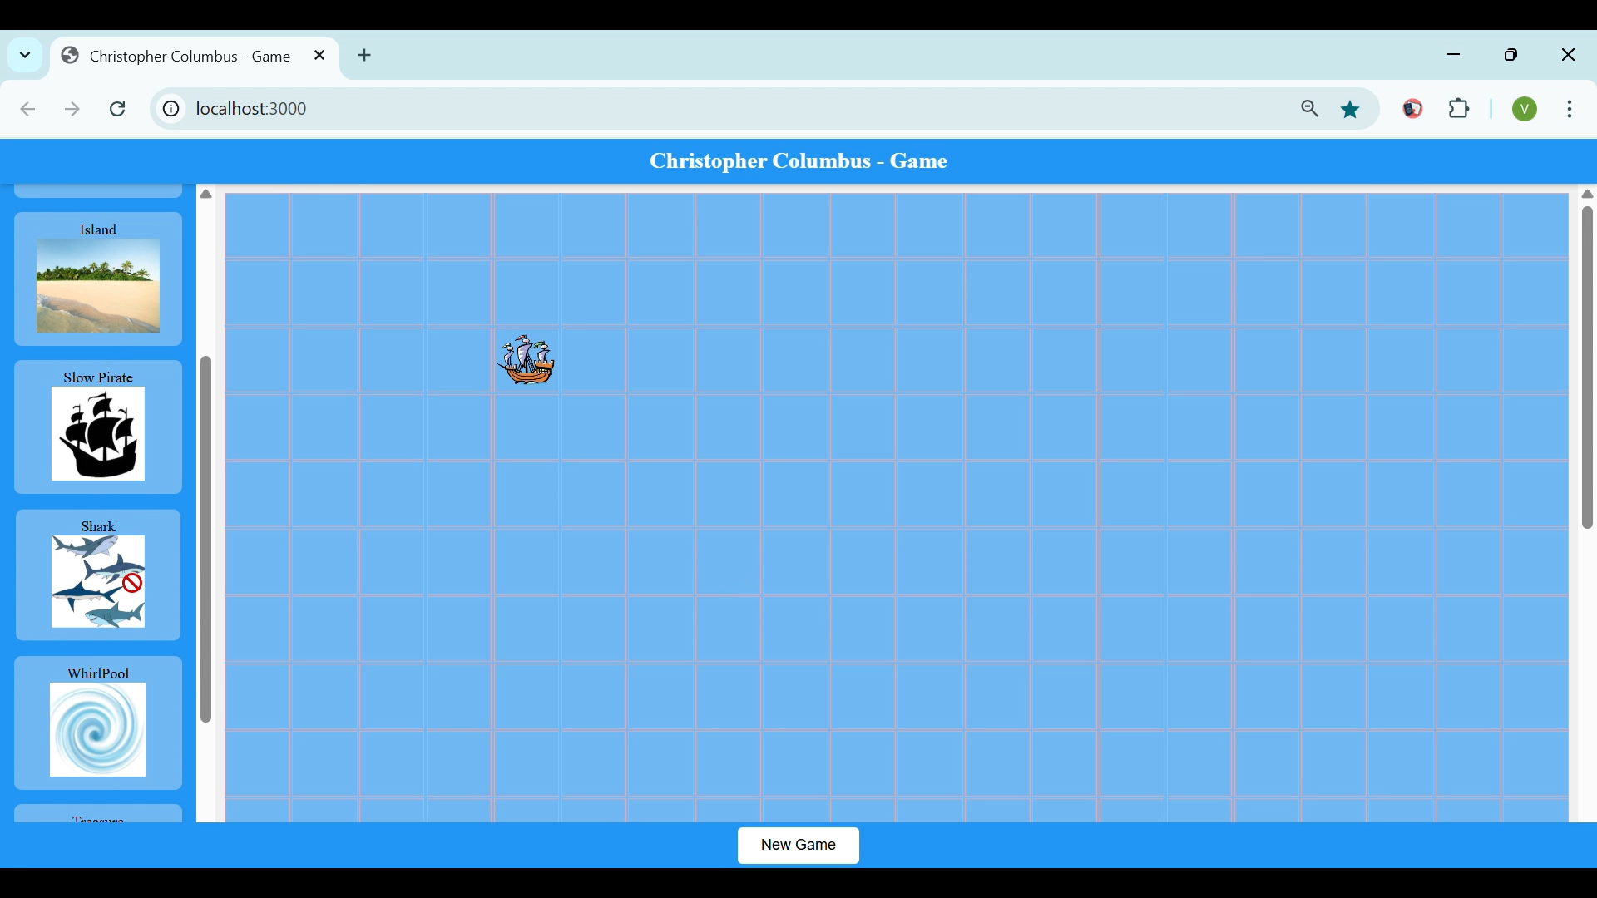
Game Functionality Sea Creatures – Visitor Design Pattern – Kill any ship

Slide 13
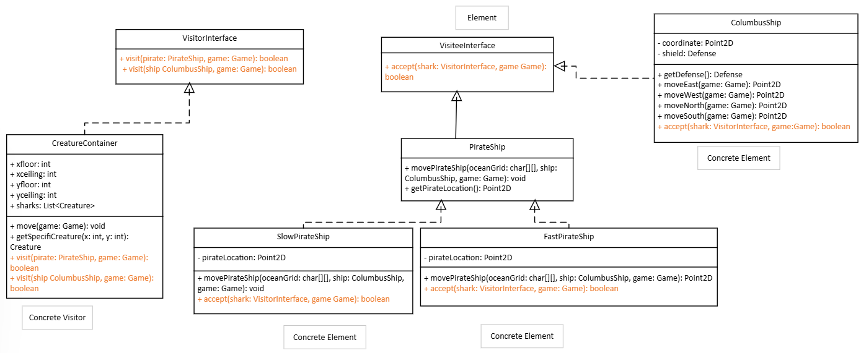
UML Diagrams Visitor Design Pattern

Slide 14
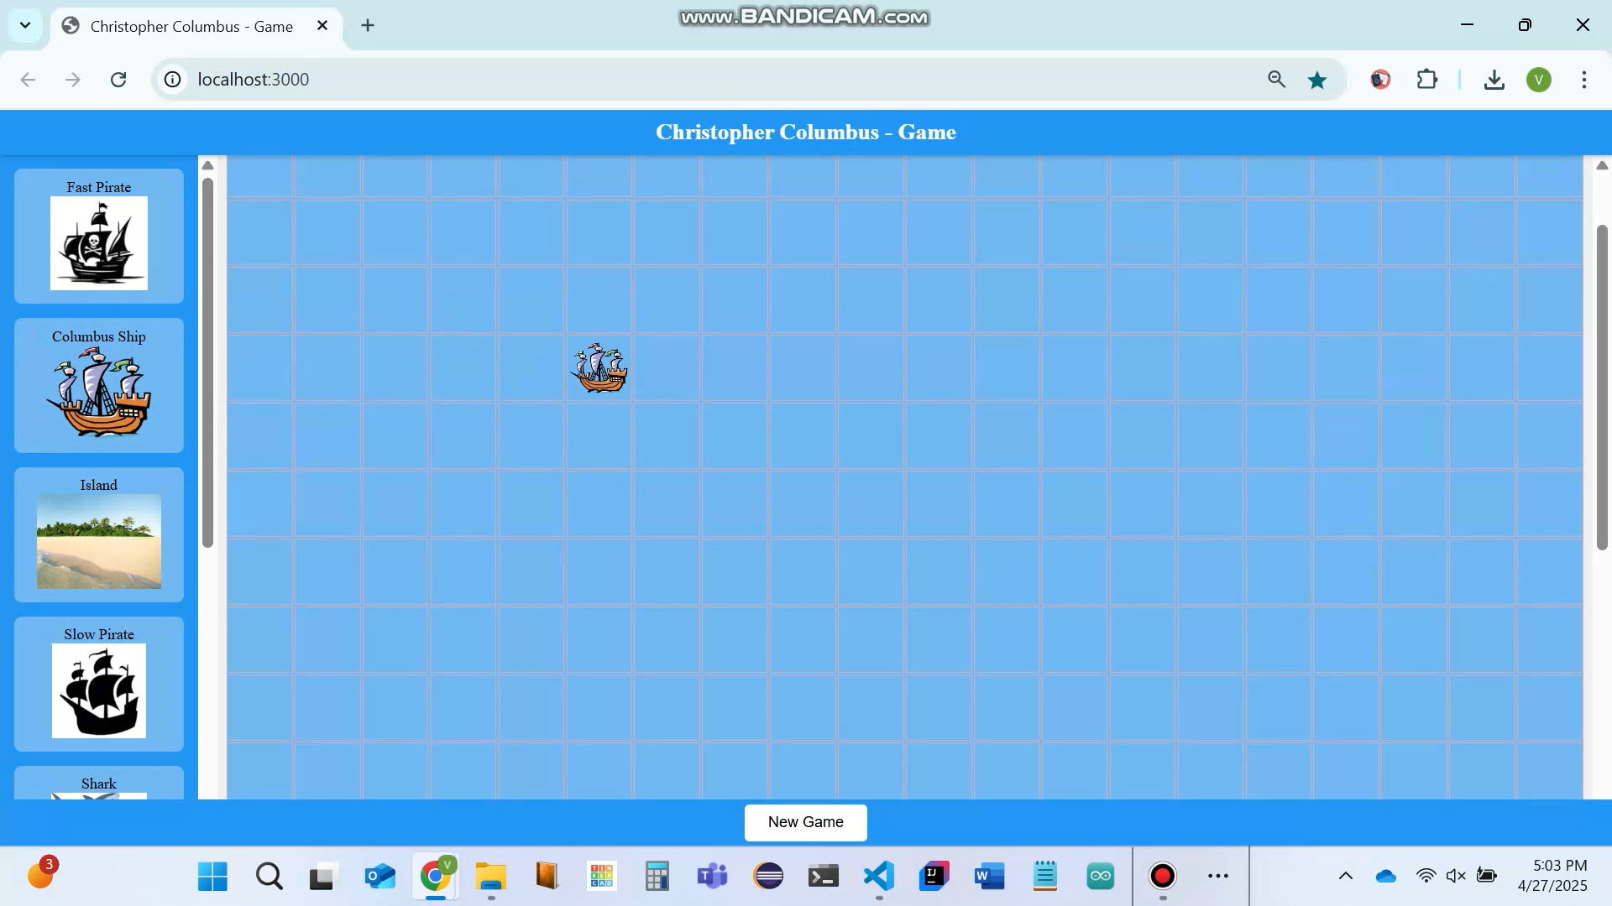
Game Functionality Shield - Decorator Design Pattern

Slide 15
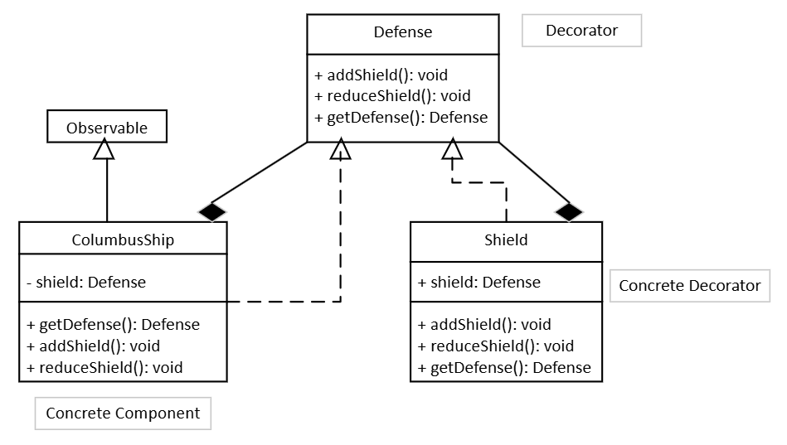
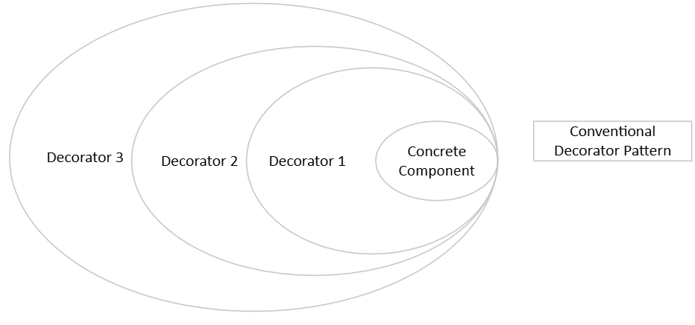
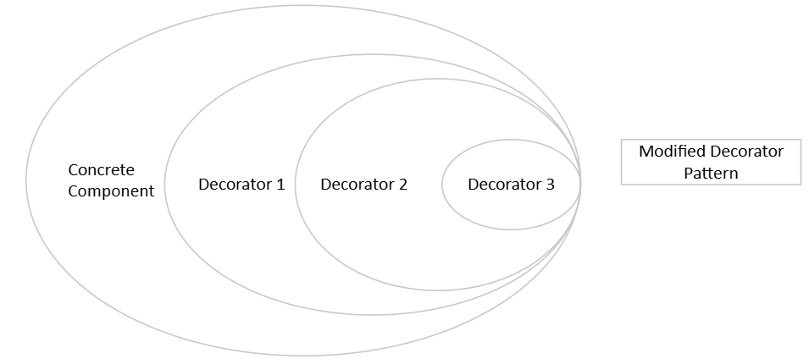
UML Diagrams Decorator Design Pattern

Slide 16
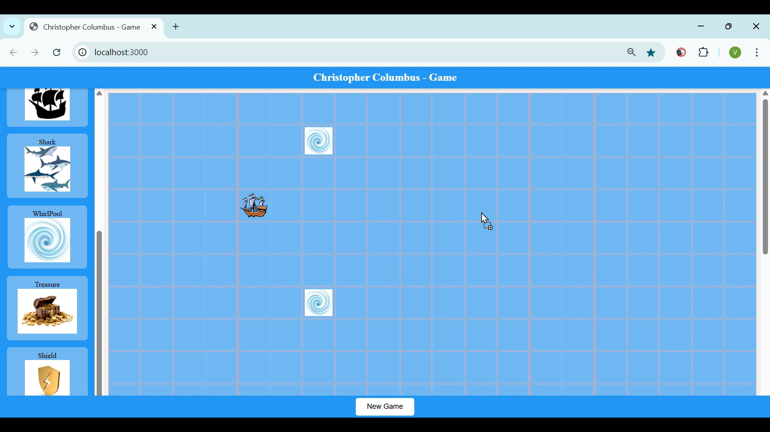
Game Functionality Whirlpools

Slide 17
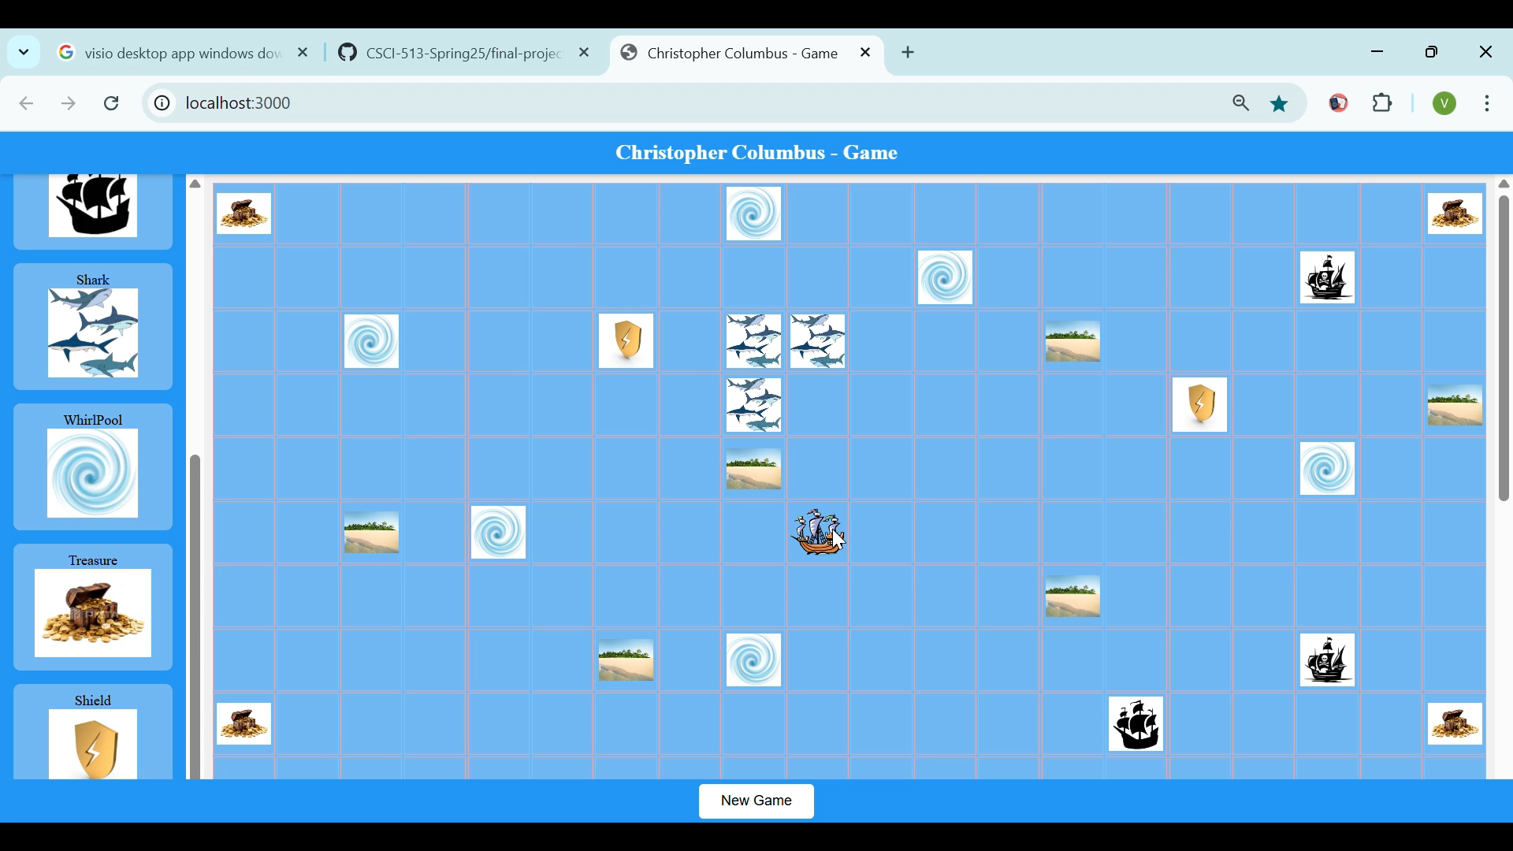
Game Functionality Columbus Wins

Slide 18
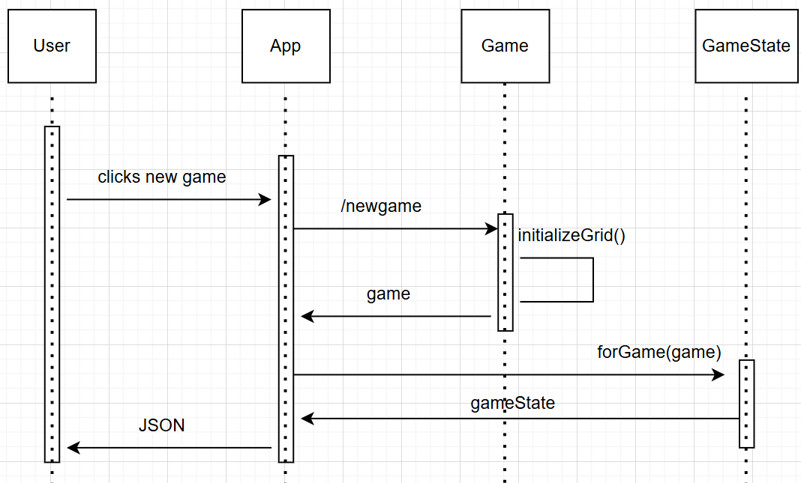
Sequence Diagrams New Game

Slide 19
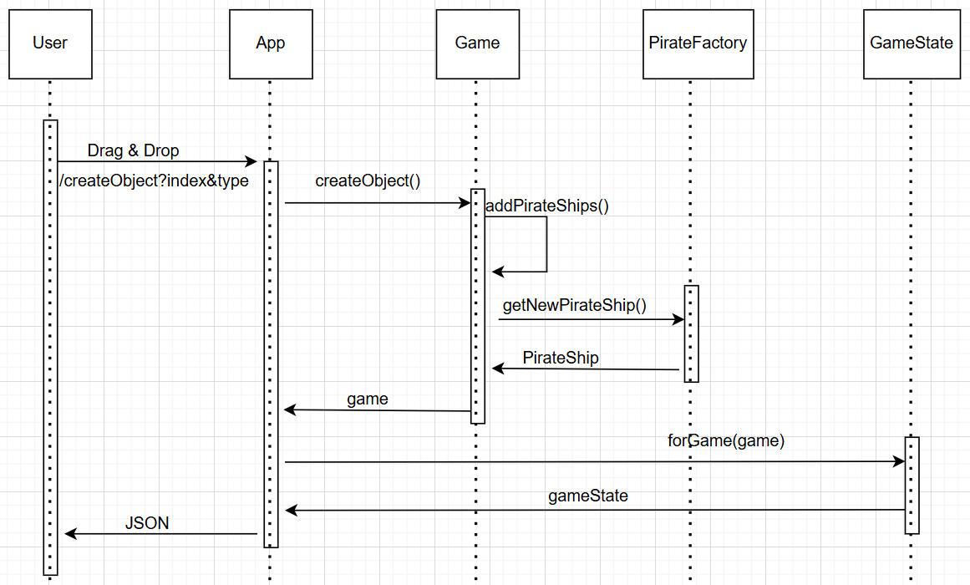
Sequence Diagrams Pirate Creation

Slide 20
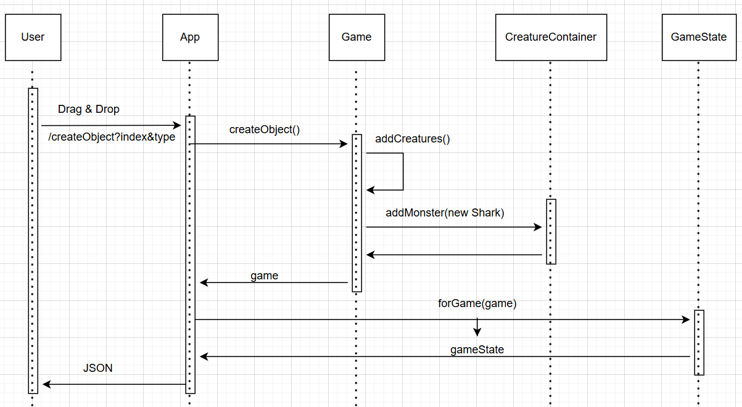
Sequence Diagrams Creature

Slide 21
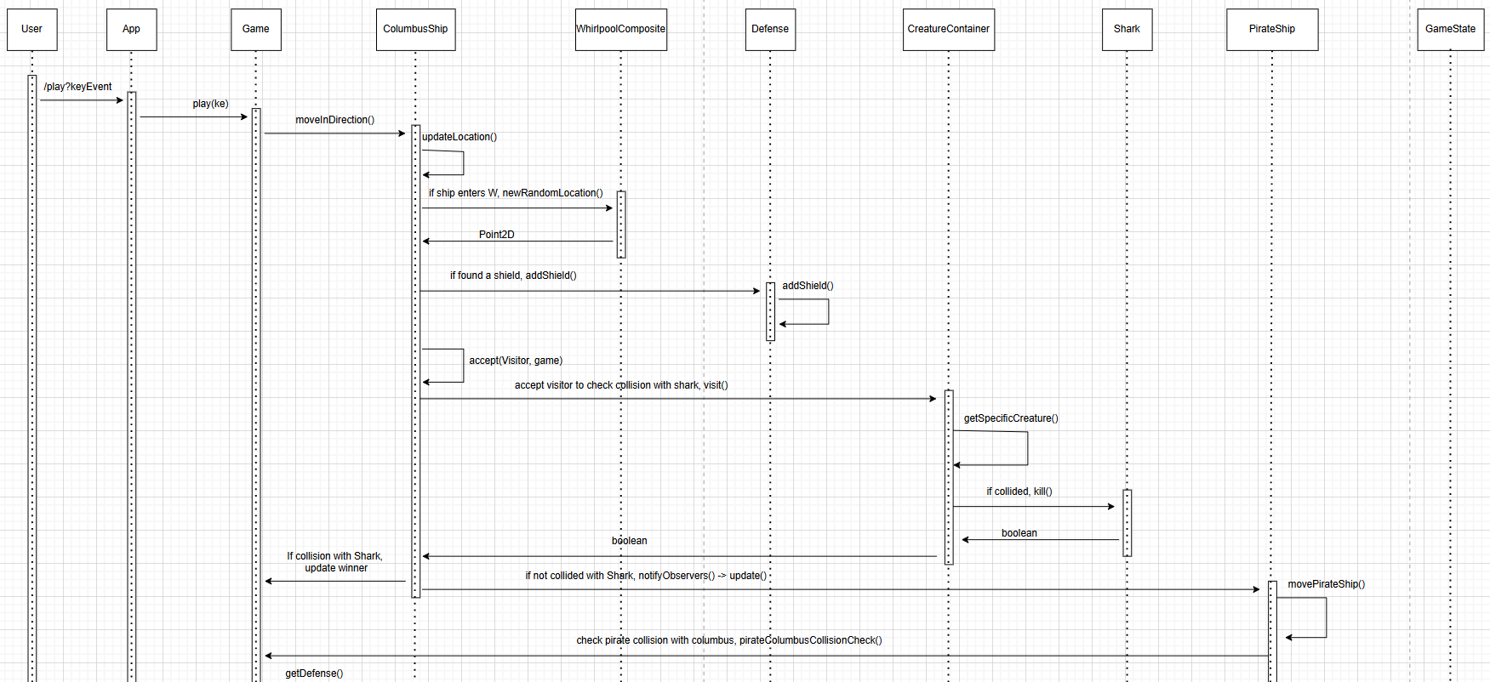
Sequence Diagrams Play

Slide 22
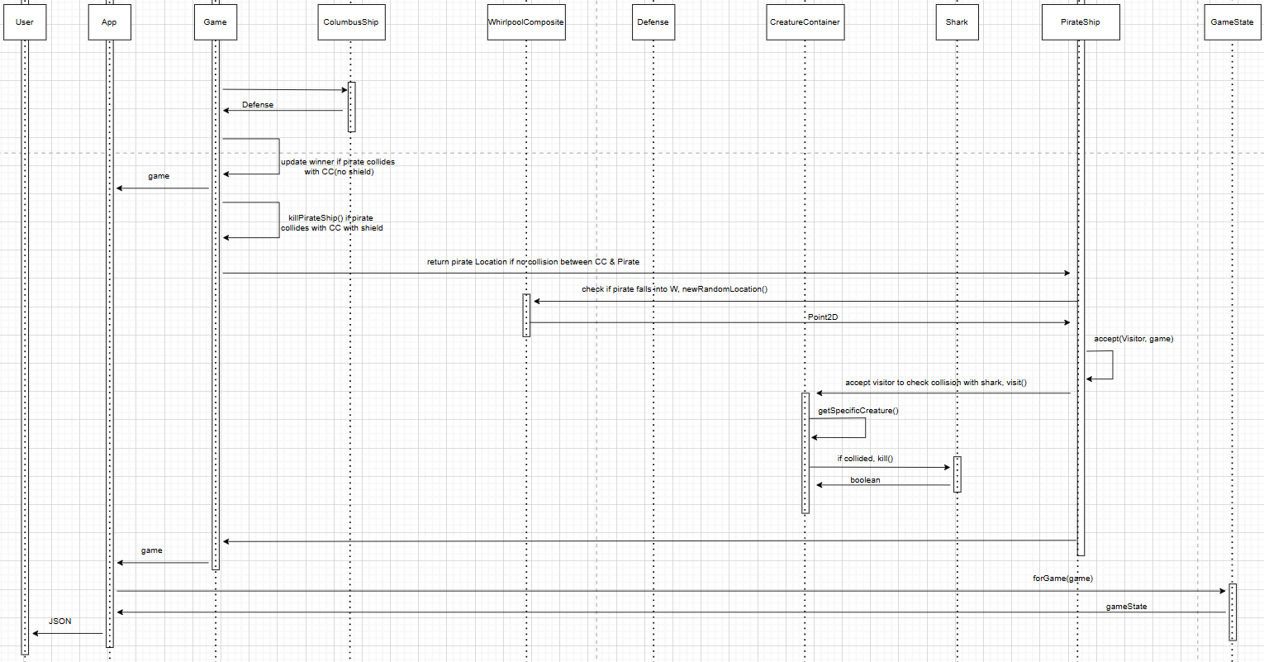
Sequence Diagrams Play

Slide 23
Test Cases
16 Scenarios implemented for Columbus & Pirate Ships.
ColumbusShip Test Cases:
moveEastTest
moveEastWithObstacleTest
moveEastWithWhirlPoolTest
columbusWinsTest
columbusWinsTest
columbusEntersWhirlpoolWithObstaclesTest
columbusKillPirateWithShieldTest
columbusEntersSeaCreatureTest
PirateShip Test Cases:
movePirateShipTest
movePirateShipWithObstacleTest
createPirateShipTest
avoidPirateShipCollisionTest
captureColumbusTest
pirateEntersWhirlpoolTest
pirateEntersSeaCreatureTest
pirateEntersWhirlpoolWithObstaclesTest

Slide 24
Design Highlights
Authentic Design. No AI. Tried to learn frontend with AI help.
Allowing the user to set their own level of complexity.
Shark visits Ships. We have kept the Pirate unaware of what Shark does. Implemented Visitor Pattern.
Special case of inheritences. Interface extending interface. PirateShip extending Observer & VisiteeInterface.
Used Github for the version control system. Didn’t push directly to main. Development environment by pushing to our branches & then finally merging.
Drag & Drop functionality is implemented in the same framework.
Used Lambda Expressions. Shark – getLocation. Instead of traditional looping.
DRY principle – Don’t Repeat Yourself. Used utility methods in the game, wherever multiple obstacle checks are needed. So, avoided multiple conditional statements.
Open for extension. Closed for modification. Expected future modifications:
All objects in one factory.
Can be extended to games like Chess Game also (Similar patterns, Eg: Decorator for Pawn to be a Queen).

Slide 25
Tasks Load Who exactly did what?
Dinesh:
Singleton
Factory Method.
Composite.
Decorator.
Drag & Drop.
Unit test cases (Columbus)
UML & Sequence.
VCS
Venkata:
Strategy.
Composite
Visitor.
Winner in both front end & backend.
Unit test cases (Pirate).
UI appearance.
Videos &
Slides.

Slide 26
Documentation
Requirements document link.
https://github.com/CSCI-513-Spring25/final-project-group-projects-dinesh-venkata/tree/main/back-end/Requirements
Referred StackOverFlow, Youtube link for the Drag & Drop functionality.
javascript - What is --openssl-legacy-provider in Node.js v17? - Stack Overflow
https://youtu.be/u65Y-vqYNAk?si=eds8KK1-CdUBVR1I
https://youtu.be/DVqVQwg_6_4?si=pk6zkXfVFN3hdQNx

